Slide 1

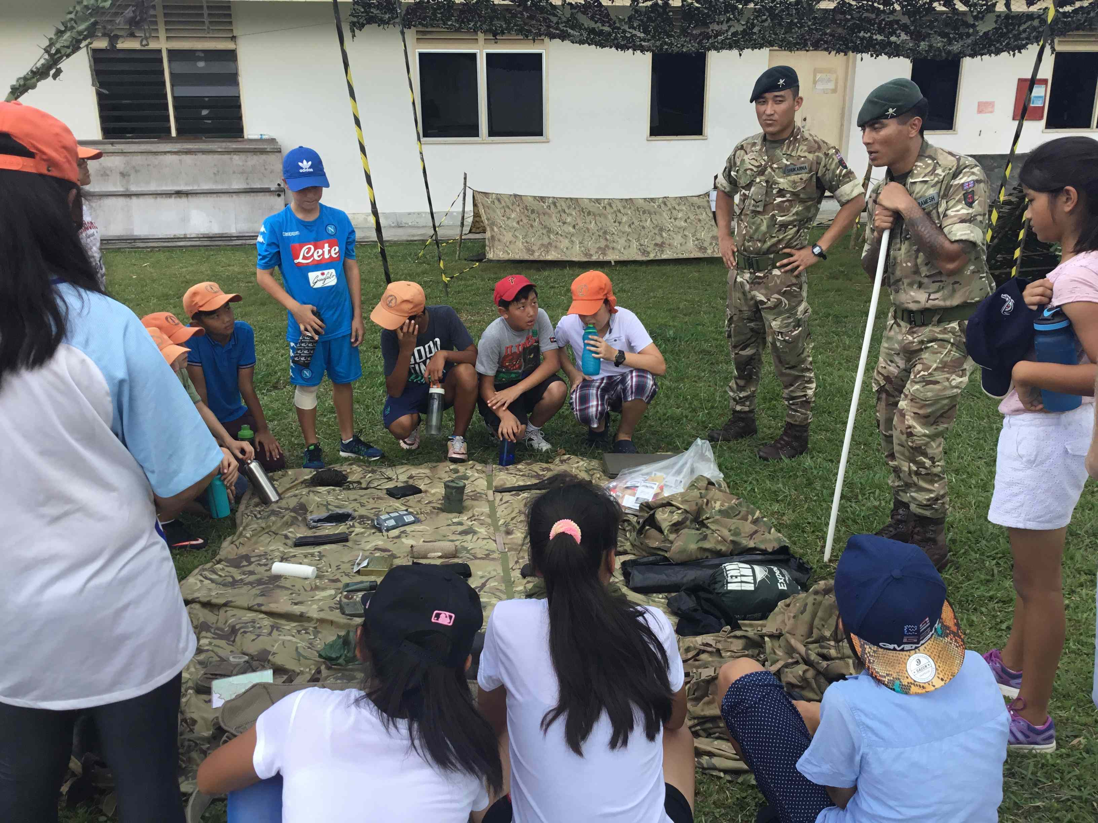
Wellbeing Initiative

Slide 2

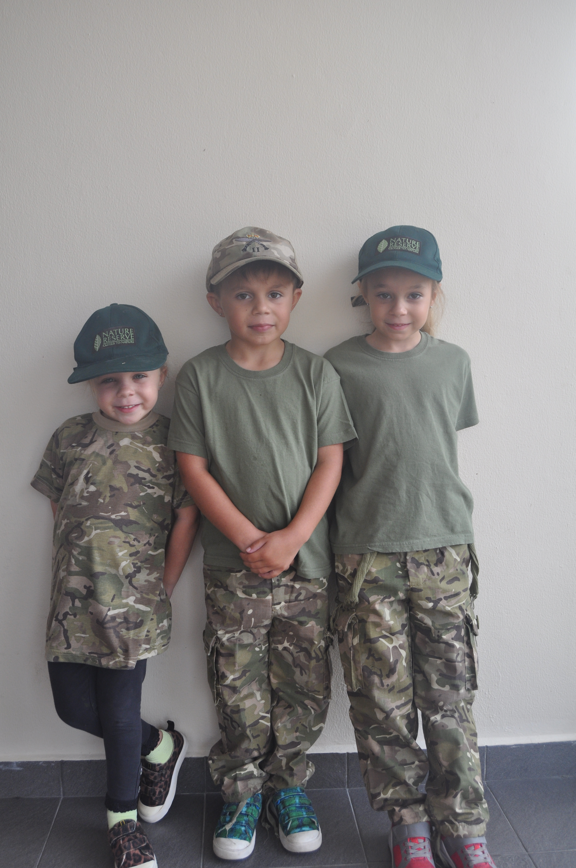
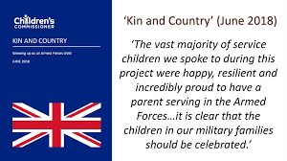
-Anxious
-Celebrated

Slide 3

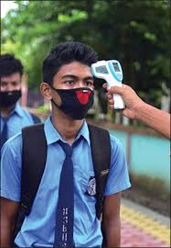

Slide 4


“a state of feeling good about ourselves and the way our lives are going”
= academic achievement

Slide 5

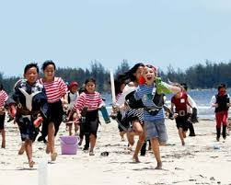
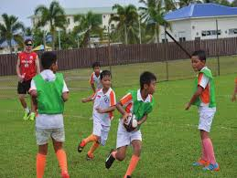
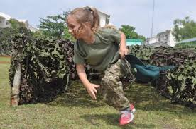

Slide 6



Wellbeing Initiative - 3 elements
Evaluate
2. Belonging
3. Cater for all needs (individual assessments)

Slide 7
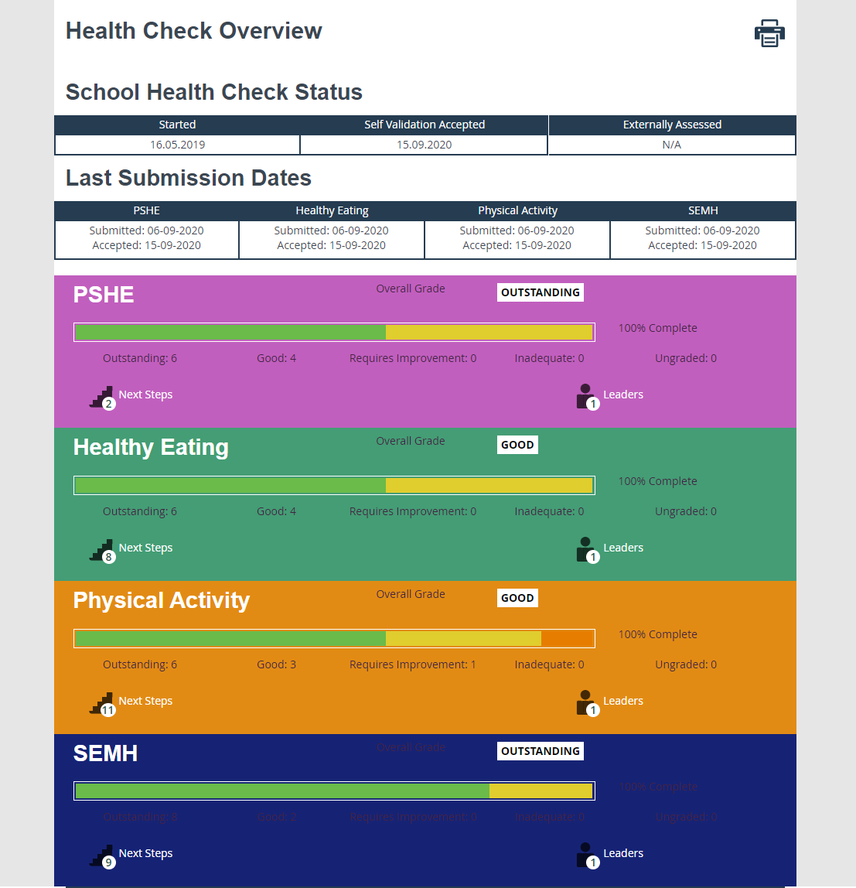

Slide 10
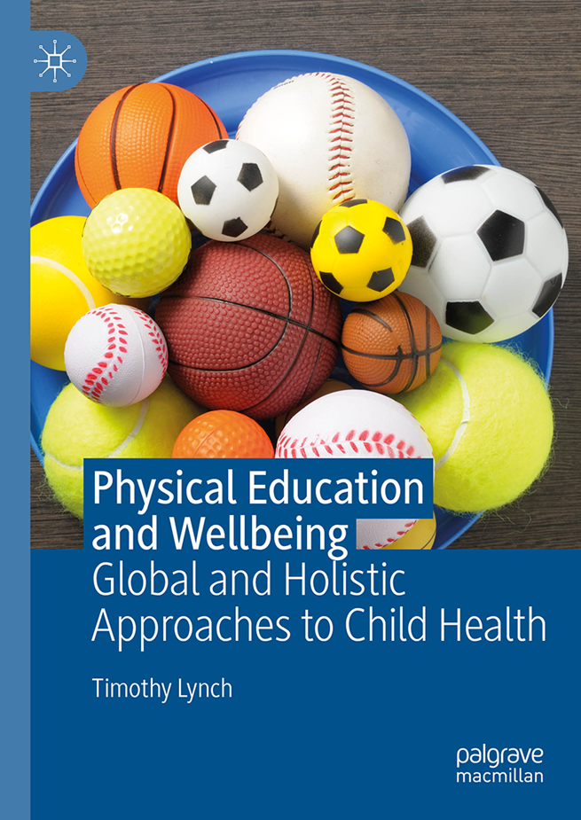
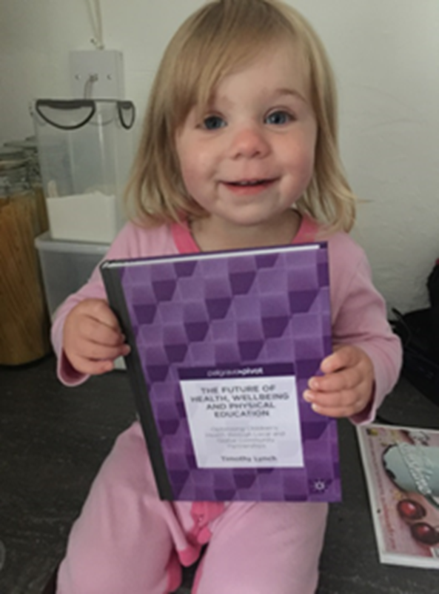

Infrastructure
Wellbeing Lead
new PE specialist
Jungle School (Forest School) Coordinator
Learning Lead teacher
EAL Lead teacher
Child Wellbeing Officer
Family Liaison Officer

Slide 11
Feeling good – How do you feel?
Having friends (positive relationships)?
Understand and manage our feelings?
Having interests…
Have hope (feel positive about the future)?

Slide 12

3 drivers
Learning powers
Community (partnerships & belonging)
Citizenship (values)

Slide 13
Curious
Courage
Explore
Reflect
Creative
Communicate
Energy
Resilient

Slide 14


Slide 15

“there is no higher priority in life than health. Without it, all other skills lack meaning and utility”
(Pangrazi, 2000, p. 18).

